Slide 1

SUPER SWEEPER
ENGINE PROOF
Betsu Ni Team

Slide 2
Brief Story

Slide 3
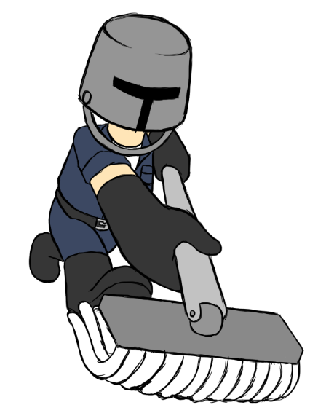
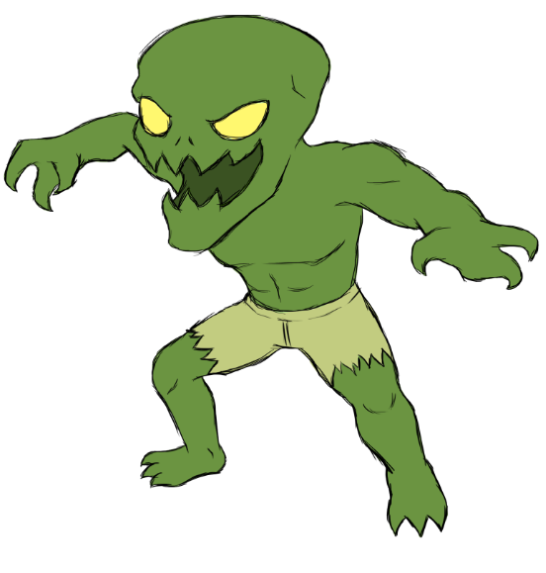
Brief Story
Jeremy Heisenberg, the only janitor in the age of zombie apocalypse. He got many requests to travel across the island to clean up the messes that the zombie created. His biggest goal is to defeat Krale, the clever zombie who can use any tool in the environment to his favor.

Slide 4
Gameplay

Slide 5



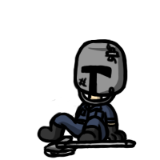
Gameplay
The player is going to play as Jeremy Heisenberg, the janitor.
The objective is to kill the zombies and survive to go to the next level.

Slide 6

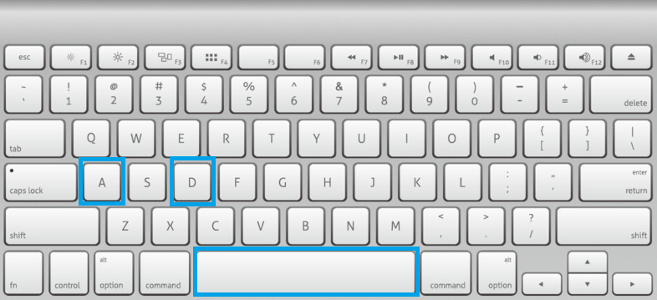
Gameplay
A- Walk backward SPACE- Jump
D- Walk forward Left mouse- Attack
*For engine proof

Slide 7
Development

Slide 8
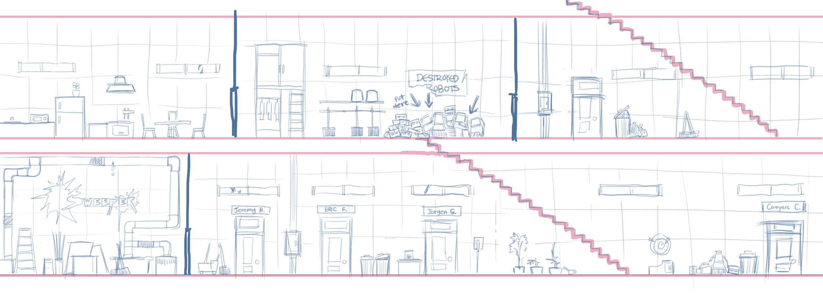
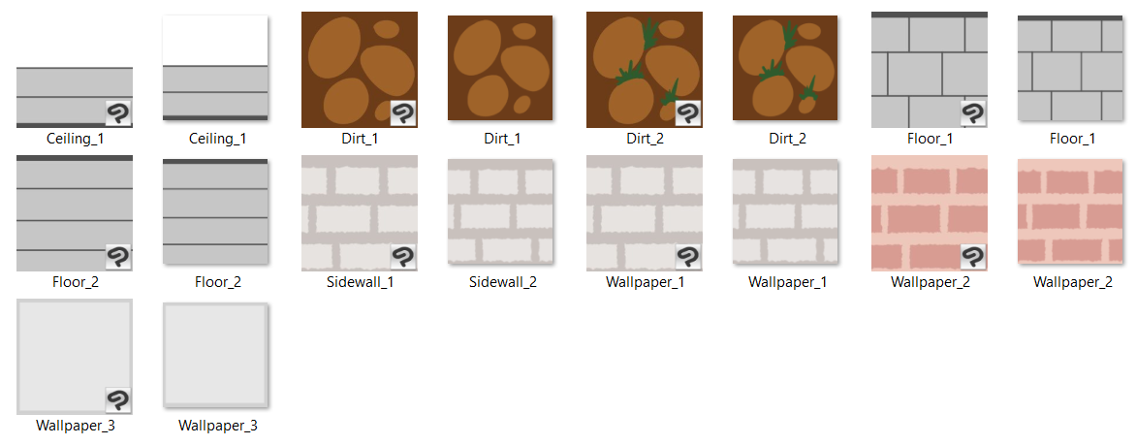
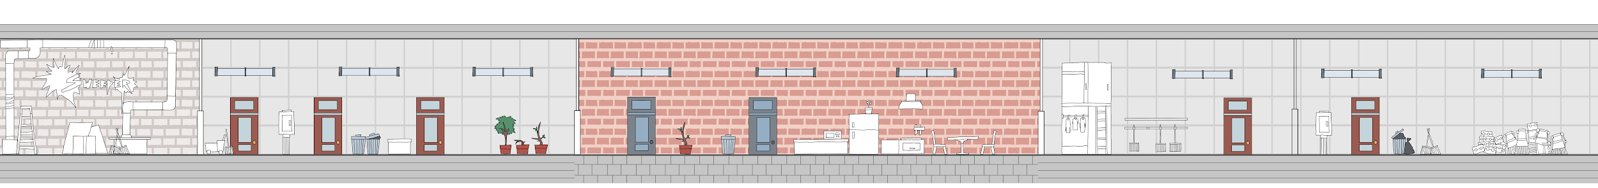
Background development
The first design was a two-floor level. Later changed to one long stage.
Tilemap usage is added in later version.

Slide 9
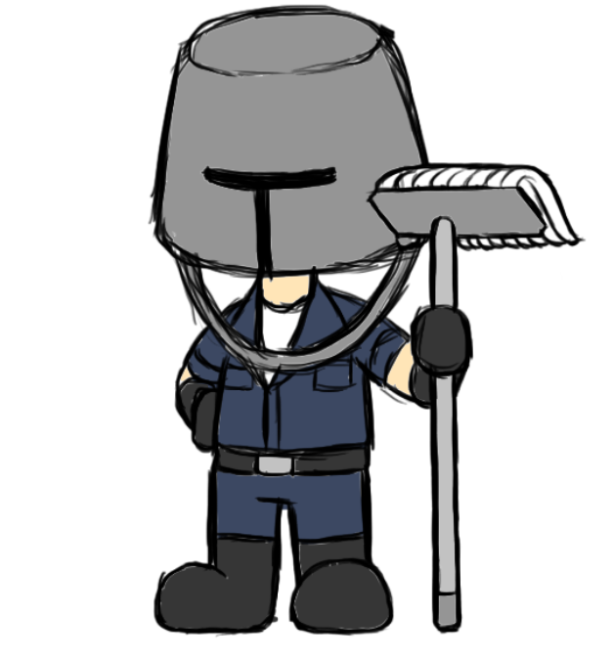

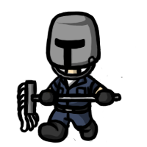
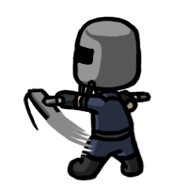
Main character development
First one drawn as a reference. Changed to artstyle in later versions and add more movements and actions.

Slide 10
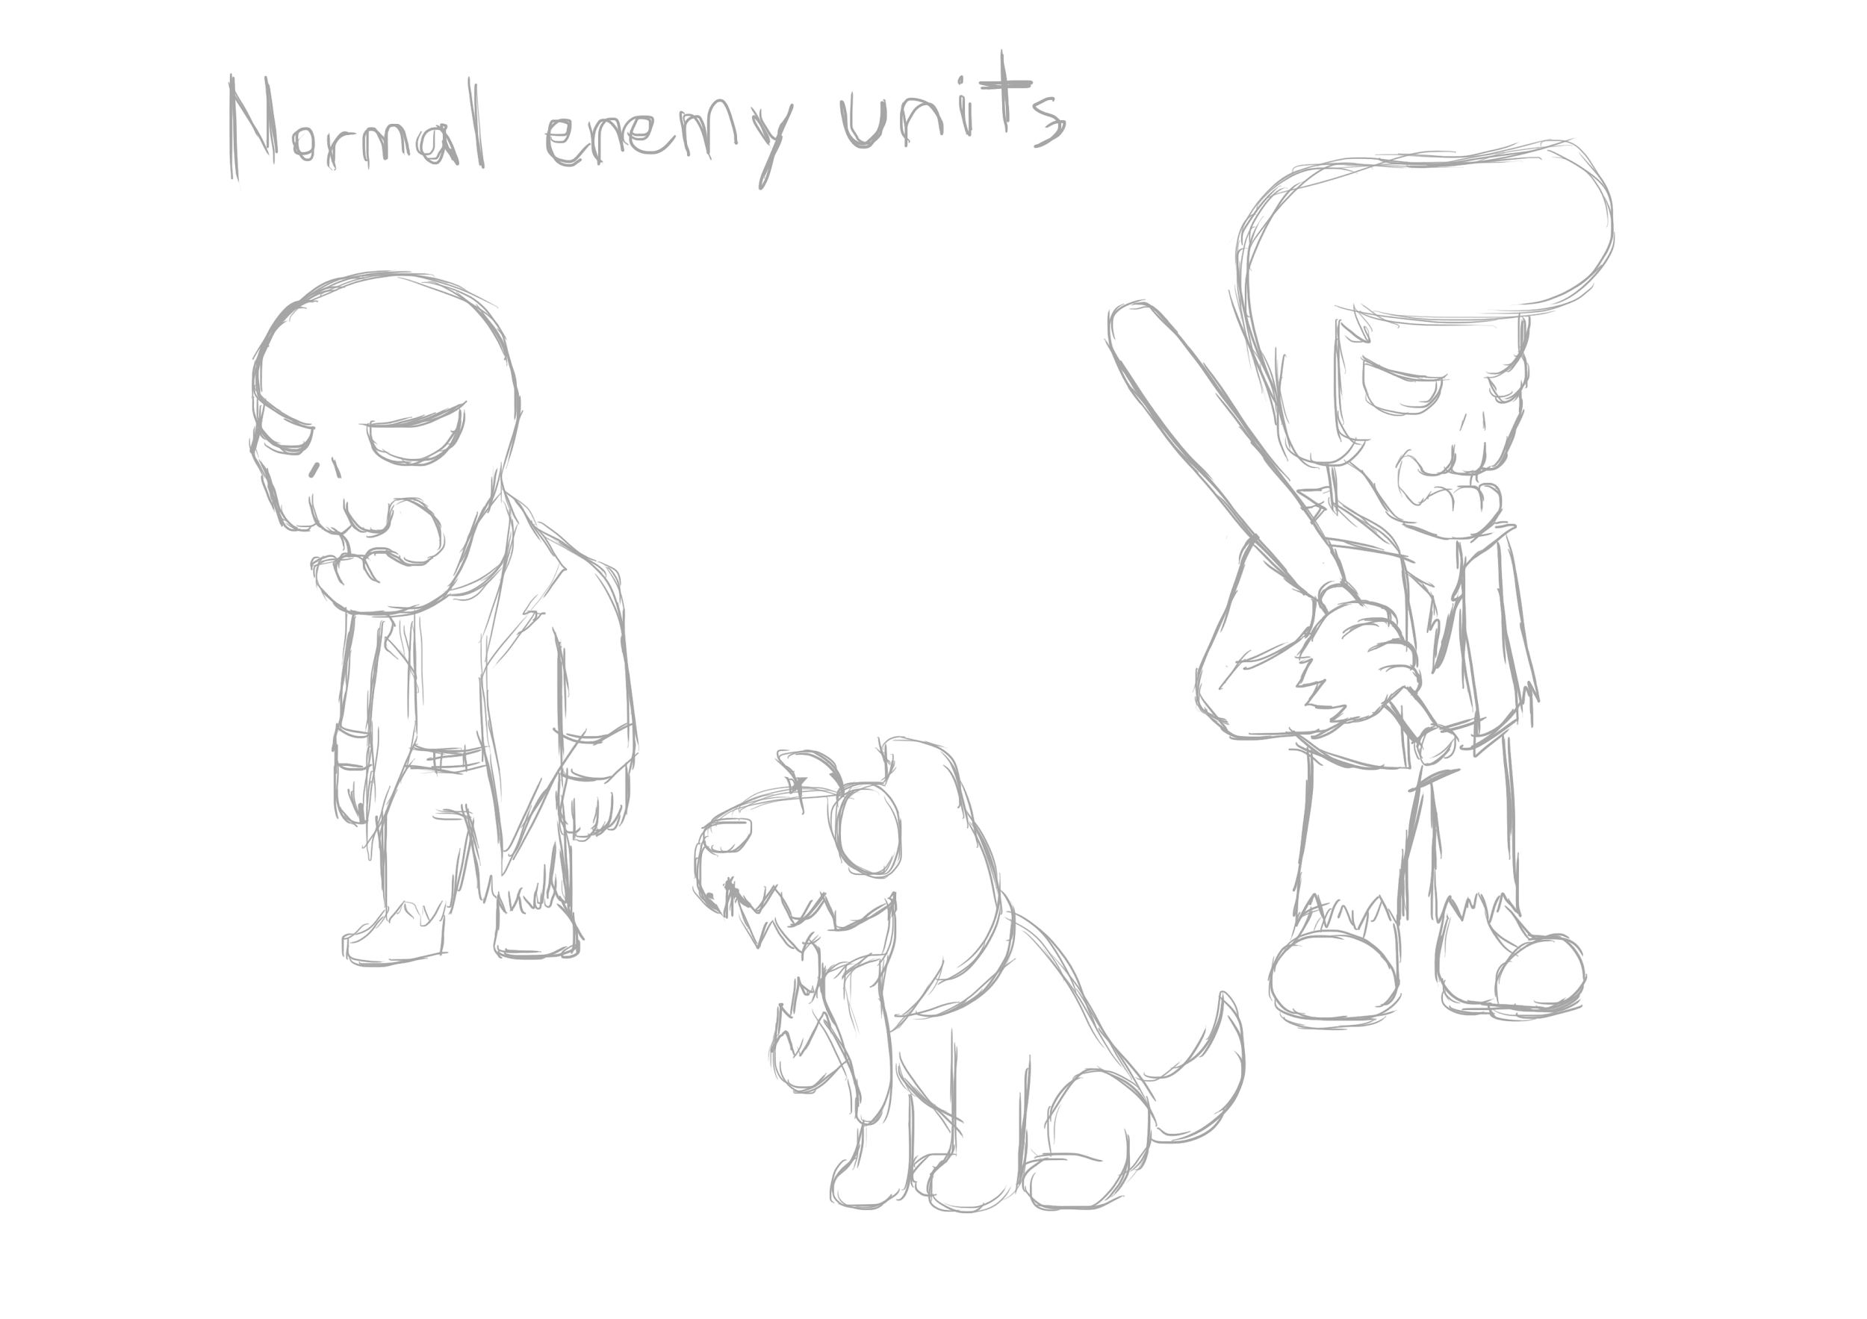






Enemy development
First, sketch the enemies. After that create one zombie, every actions. Then change minor details for next zombie.

Slide 11
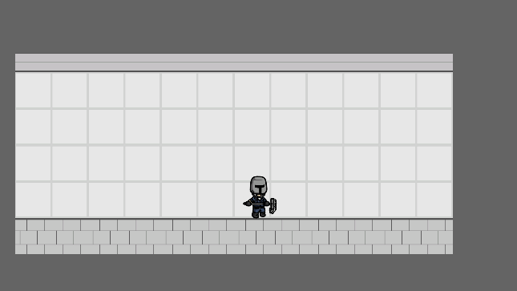
Game development
1st version
+tilemap
+character movement
+character attack

Slide 12
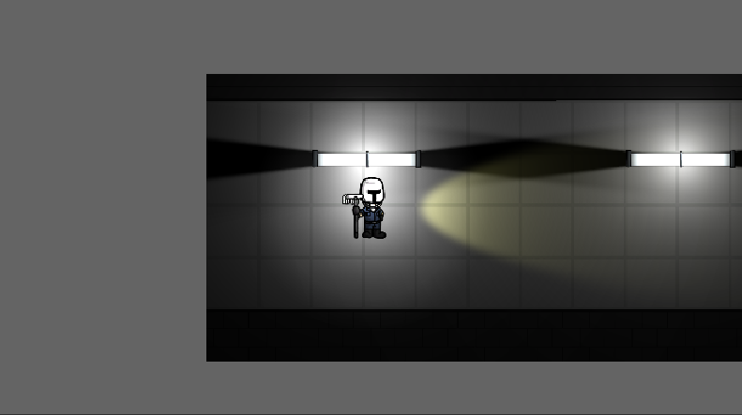
Game development
2nd version
+objects
+lighting
+level restart
+flashlight (yellow)

Slide 13
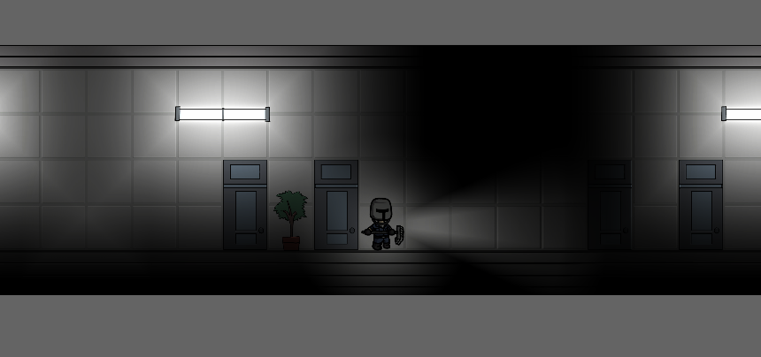
Game development
3rd version
-flashlight (yellow)
+flashlight (white)
+more objects

Slide 14
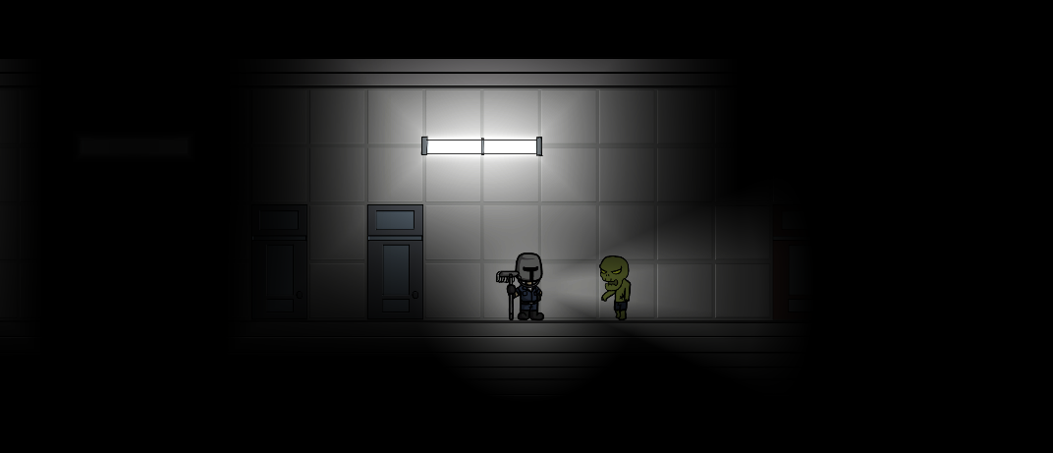
Game development
4th version
+more objects
+zombies
+zombie AI
+character can kill zombie
+character can die

Slide 15
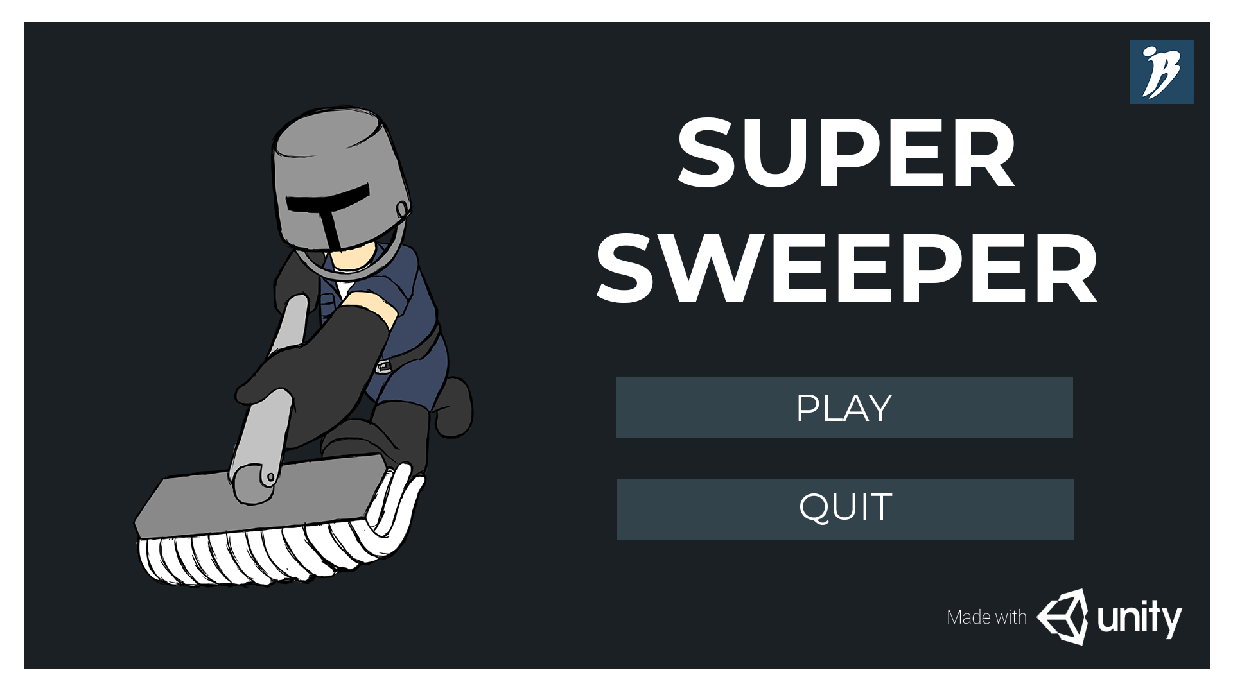
Game development
5th version
+logo
+title screen

Slide 16
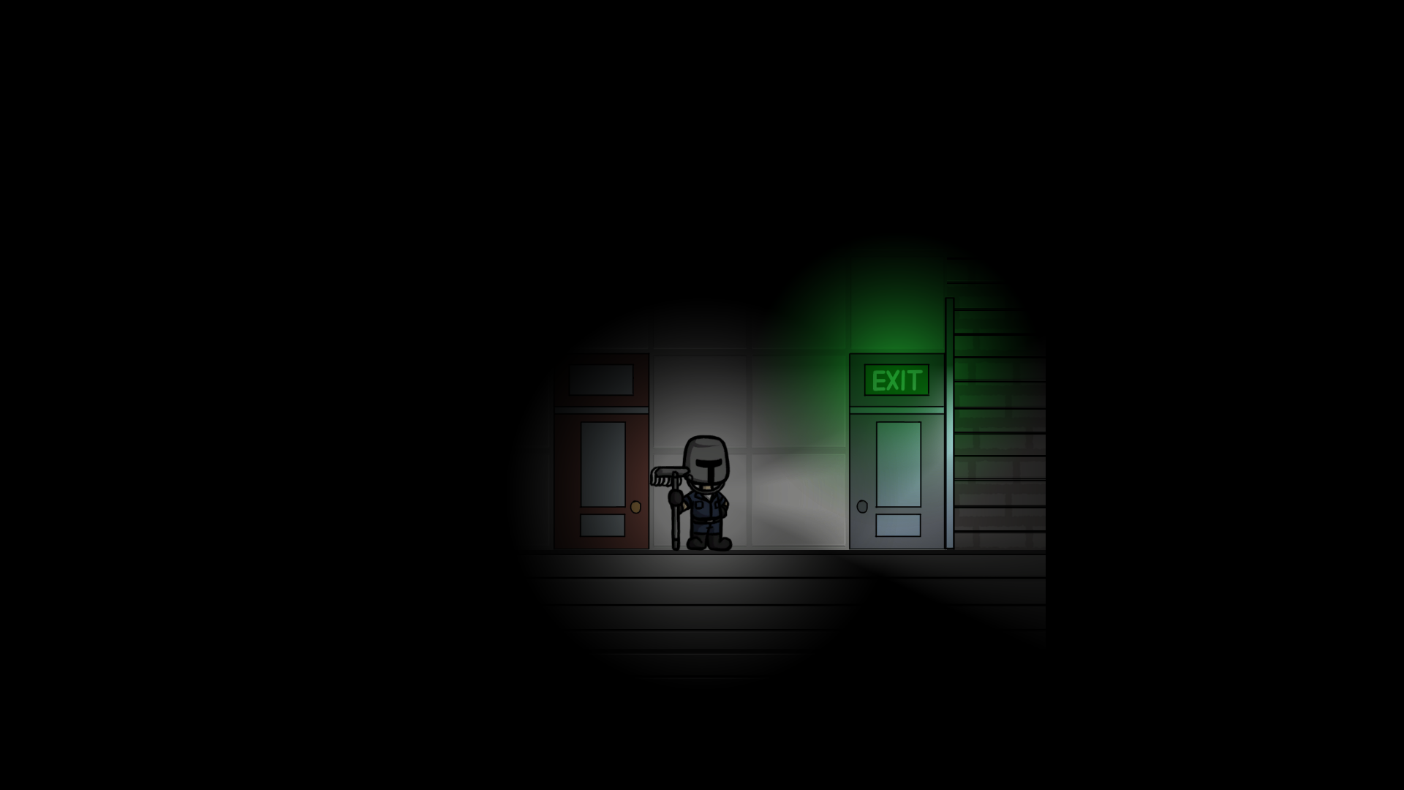
Game development
6th version
+return to title upon death, end

Slide 17
What have been done?

Slide 18
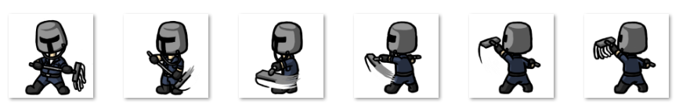


What have been done?
Character movement and attack (1 type)
Sprites for main character
Tilemap
Lighting
Zombie 1 and Zombie 2
Zombie AI

Slide 19
Alpha

Slide 20
Alpha
Sound effects
Stage Select
Mop bar
Heavy attack
Score system
2 more levels
Boss enemy
You win & You lose screen

Slide 21
Resources

Slide 22
Resources
Font
Montserrat (Title, you win, you lose)
Keyboard pic
https://www.cleanpng.com/png-computer-keyboard-macintosh-magic-mouse-bluetooth-424018/
Mouse pic
https://www.wpclipart.com/computer/mouse/computer_mouse.png.html

Slide 23
THANK YOU!

